Slide 1
Kubernetes workshop @ Linux Root conference
Viktor Tsykunov
Software Engineering Lead
Commercial Software Engineering
vtsykun@microsoft.com

Slide 2




















































Security and management
Platform services
Hybrid
operations
Compute
Web and mobile
Developer services
Portal
Azure AD Connect Health
Cloud services
Service fabric
Web apps
API apps
API management
Visual Studio
Azure SDK
Active Directory
AD Privileged Identity mgmt.
Batch
Remote app
Mobile apps
Logic apps
Notification hubs
Team project
Application insights
Multi-factor Authentication
Backup
Integration
Analytics and IoT
Data
Automation
Operational insights
Storage queues
Biztalk services
HDInsight
Machine learning
SQL Database
SQL data warehouse
Key vault
Import/export
Hybrid connections
Service bus
Data factory
Event hubs
Redis cache
Search
Store/ marketplace
Site recovery
Media and CDN
VM Image Gallery and VM Depot
Stream analytics
Mobile engagement
DocumentDB
Tables
Media services
Content Delivery Network (CDN)
StorSimple
Infrastructure services
Virtual machines
Network attached storage
Software defined networking
Windows
Linux
Containers
BLOB storage
Azure files
Premium storage
Virtual network
Load Balancer
DNS
Express
route
Traffic Manager
VPN Gateway
Application Gateway
Datacenter infrastructure (24 regions, 19 online)—More than AWS and Google combined

Slide 3




Requirements
Activate Azure Trial or Azure Pass: https://azure.com
Install Azure CLI: https://docs.microsoft.com/en-us/cli/azure/install-azure-cli
Make sure Docker is running on your PC. If not download and install it from https://www.docker.com/community-edition
Have your favorite code editor ready.
For me it’s Visual Studio Code: https://code.visualstudio.com/download

Slide 4
Introduction
Microservice Architectural Style

Slide 5
Characteristics of Microservices
Modeled around business concepts
Decentralized
Deployed independently
Microservice
Hide implementation detail
Automated
Isolate failure

Slide 6

SOA == Microservice Architecture
Microservices are a modern interpretation of service-oriented architectures used to build distributed software systems.

Slide 7
Characteristics of Microservices
Modeled around business concepts
Decentralized
Deployed independently
Microservice
Hide implementation detail
Automated
Isolate failure

Slide 8
SOA + Ease of DevOps = Microservice Architecture

Slide 9
Monolith
Front-End
Database
Cart
Catalog
Customer
Order
Inventory
Shipping

Slide 10
Missing out
Front-End
Database
Technology heterogeneity
Optimized scaling
Resilience
Composability
Independent deployment
Distributed development
Cart
Catalog
Customer
Order
Inventory
Shipping

Slide 11


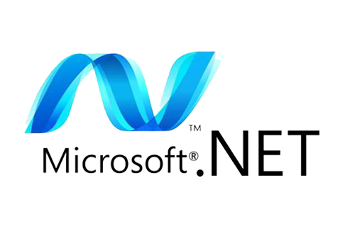

Technology heterogeneity
Front-End
Catalog
Customer
Order
Shipping
Inventory
Cart
Redis
Doc DB
Azure SQL
Azure SQL
My SQL
Doc DB
Redis

Slide 12
Optimized Scaling and resilience
Front-End
Front-End
Front-End
Catalog
Catalog
Customer
Order
Order
Shipping
Inventory
Cart
Catalog
Catalog
Customer
Order
Order
Inventory
Cart
Order
Order

Slide 13
Independent deployment
Front-End
Front-End
Front-End
Customer
Order
Order
New Shipping
Inventory
Cart
Catalog
Catalog
Shipping
Catalog
Catalog
Customer
Order
Order
Inventory
Cart
Order
Order

Slide 14
Distributed development
Catalog
Customer
Order
Shipping
Inventory
Cart
Source Code
Source Code
Source Code
Source Code
Source Code
Source Code

Slide 15
Operational challenges

Slide 16
Monolith deployment
App instance 1
App instance 2
App instance 3
Cart
Catalog
Cart
Catalog
Cart
Catalog
Customer
Order
Customer
Order
Customer
Order
Inventory
Shipping
Inventory
Shipping
Inventory
Shipping
Guest OS
Guest OS
Guest OS
Hypervisor
Physical machine

Slide 17
Monolith deployment artifacts
Deployment archive
Deployment archive
Deployment archive
App Server
Web Server
App Server
Web Server
App Server
Web Server
Env variables
Files
Folders
Env variables
Files
Folders
Env variables
Files
Folders

Slide 18
Microservice on virtual machines
Catalog service Instance
Catalog service Instance
Catalog service Instance
Deployment archive
Deployment archive
Deployment archive
App Server
Web Server
App Server
Web Server
App Server
Web Server
Env variables
Files
Folders
Env variables
Files
Folders
Env variables
Files
Folders
Guest OS
Guest OS
Guest OS
Hypervisor
Physical machine

Slide 19
Containers to the rescue
Deployment file
Deployment file
Deployment file
App Server
Web Server
App Server
Web Server
App Server
Web Server
Env variables
Files
Folders
Env variables
Files
Folders
Env variables
Files
Folders
Container
Container
Container
Container Engine
Host OS
Physical machine

Slide 20

Docker
Union Filesystem
Central Registry
Easy-to-use tooling

Slide 21
Container Adoption

Slide 22
Container Adoption
Containers

Slide 23
Container Adoption

Slide 24

Container Adoption
Application
Container
Operating System
Server

Slide 25

Container Sprawl

Slide 26
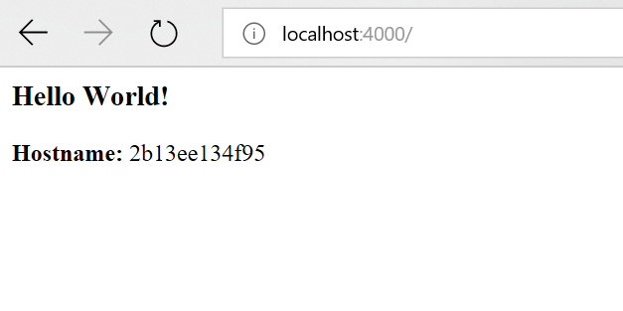
Challenge #0 – Let’s crate our first container
Carte simple web application:
Documentation: https://docs.docker.com/get-started/part2/

Slide 27
Challenge #0. Solution
Crate empty folder
Create 3 files:
Dockerfile ->
2. app.py ->
from flask import Flask
import os
import socket
app = Flask(__name__)
@app.route("/")
def hello():
html = "<h3>Hello {name}!</h3>" \
"<b>Hostname:</b> {hostname}<br/>"
return html.format(name=os.getenv("NAME", "world"), hostname=socket.gethostname())
if __name__ == "__main__":
app.run(host='0.0.0.0', port=80)
# Use an official Python runtime as a parent image
FROM python:2.7-slim
# Set the working directory to /app
WORKDIR /app
# Copy the current directory contents into the container at /app
ADD . /app
# Install any needed packages specified in requirements.txt
RUN pip install --trusted-host pypi.python.org -r requirements.txt
# Make port 80 available to the world outside this container
EXPOSE 80
# Define environment variable
ENV NAME World
# Run app.py when the container launches
CMD ["python", "app.py"]
3. requirements.txt ->
Flask
3. Crate and run container:
>docker build -t friendlyhello .
>docker run -p 4000:80 friendlyhello

Slide 28
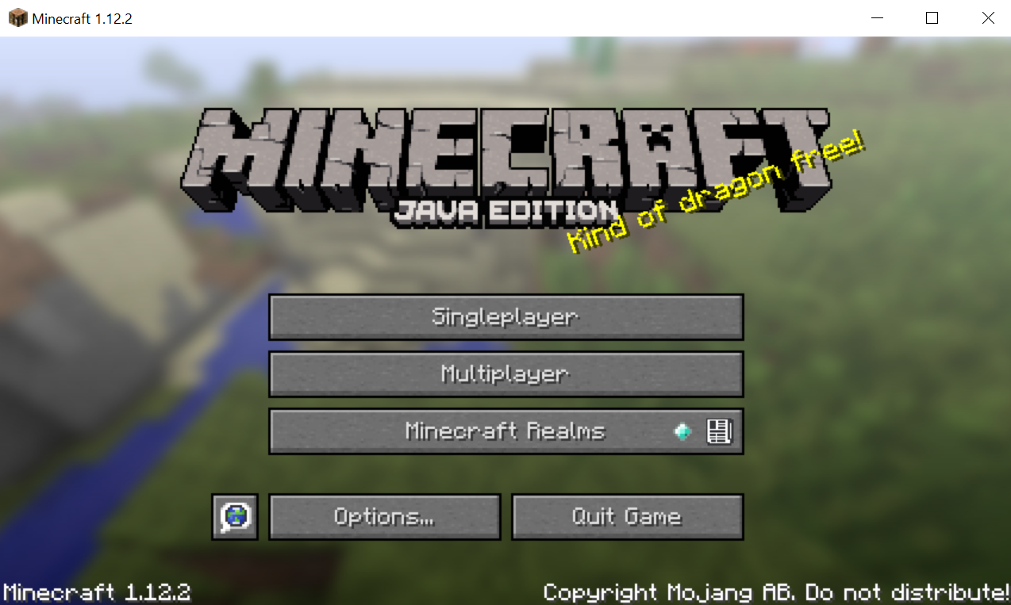
Challenge #1 – running Minecraft server on the local PC
Prepared Minecraft Server Docker container is available at: https://hub.docker.com/r/openhack/minecraft-server/

Slide 29
Challenge #1 –Solution
Check docket is running:
Docker ps
Launch Minecraft:
> docker pull openhack/minecraft-server
> docker run -d -p 25565:25565 -e EULA=TRUE openhack/minecraft-server

Slide 30
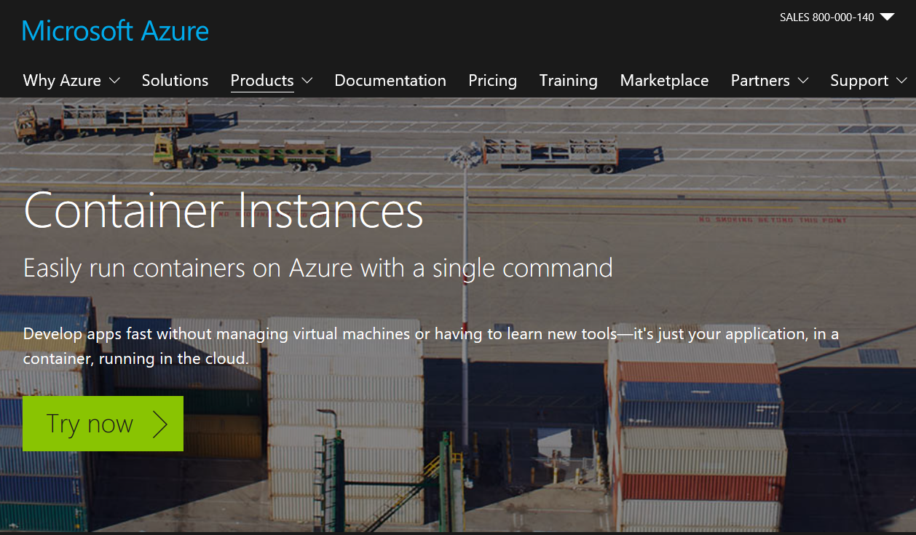
Challenge #2 – running Minecraft server in the Cloud
Prepared Minecraft Server Docker container is available at: https://hub.docker.com/r/openhack/minecraft-server/
Use Azure Container Instances:
https://azure.microsoft.com/en-us/services/container-instances/

Slide 31
Challenge #2 –Solution
Login to Azure
az login
Save some defaults:
az configure –defaults location=westus group=LinuxConf
2. Crate new Resource Group (aka Folder)
az group create -l westus -n LinuxConf
Crate Minecraft server instance:
az container create --name minecraft --image openhack/minecraft-server --dns-name-label minecraft-dns --cpu 1 --memory 2 --ip-address public --ports 25565 -e EULA=TRUE

Slide 32
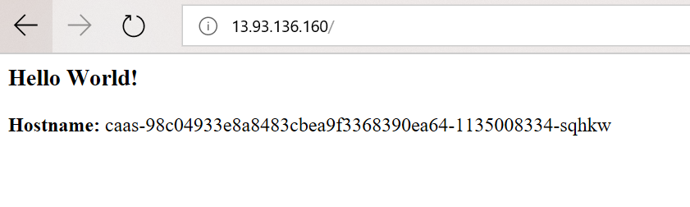
Challenge #2.1 (Optional). Run Custom Container in ACI
Run container crated in challenge #0 on Azure Container Instances

Slide 33
Challenge #2.1 (Optional). Solution
# Crate Azure container registry
az acr crate --name contRep --sku Basic
az acr login --name contRep
# Crate login/password. Login is the same as registry name. !Not the best solution - just for demo
az acr update --name contrep --admin-enabled true
az acr credential show --name contrep --query "passwords[0].value"
# Get repository name
az acr list --resource-group LinuxConf --query "[].{acrLoginServer:loginServer}" --output table
# Tag and push new container into the new repository
docker tag friendlyhello contrep.azurecr.io/friendlyhello:v1
docker push contrep.azurecr.io/friendlyhello:v1
# Check new container exist there:
az acr repository list --name contrep --output table
az container create --name friendlyhello --image contrep.azurecr.io/friendlyhello:v1 \
--ip-address public --ports 4000
# Check deployment status, look at logs:
az container list
az container attach --name friendlyhello

Slide 34
Container Orchestration

Slide 35
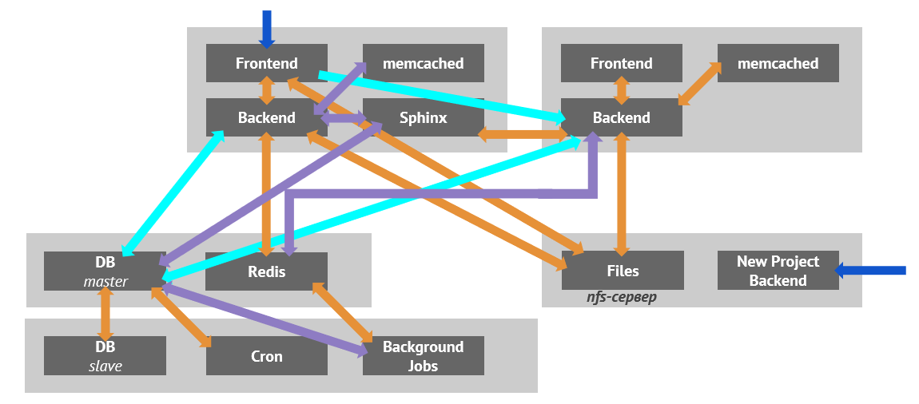
Why Container Orchestration?
Agility
Scalability
Reliability
Dmitry Stolyarov @ RootConf 2017 https://www.youtube.com/watch?v=CgCLPYJRxbU&amp=&t=8s&amp=&index=3

Slide 36
What is Kubernetes?
Open source container orchestrator that automates deployment, scaling, and management of applications
Features include:
Automatic bin-packing
Self-healing
Horizontal scaling
Service discovery and load balancing
Automated rollouts and rollbacks
Secret and configuration management
Storage orchestration
Batch execution

Slide 37
Kubernetes - Agility
Container Orchestrator
Containers
Servers

Slide 38
Kubernetes - Agility
Container Orchestrator
Containers
Servers

Slide 39
Kubernetes - Scalability
Container Orchestrator
Containers
Servers

Slide 40
Kubernetes - Scalability
Container Orchestrator
Containers
Servers

Slide 41
Kubernetes - Scalability
Container Orchestrator
Containers
Servers

Slide 42
Kubernetes - Reliability
Container Orchestrator
Containers
Servers

Slide 43
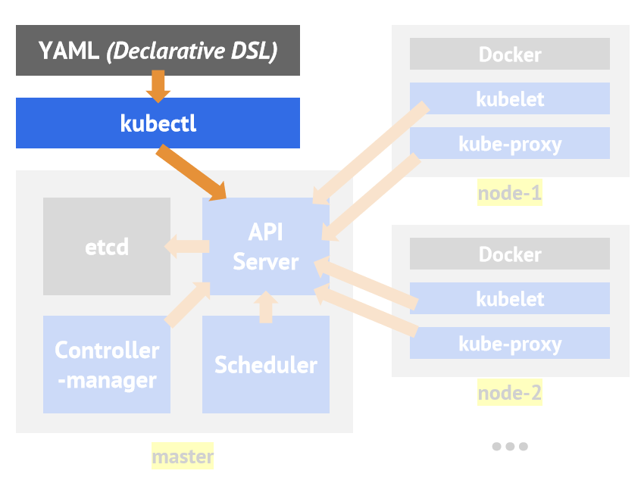
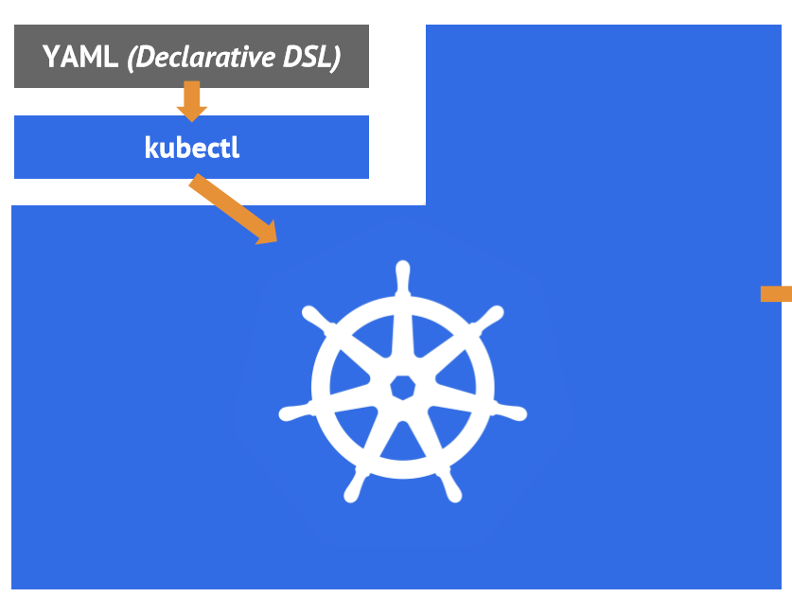
Kubernetes Architecture

Slide 44
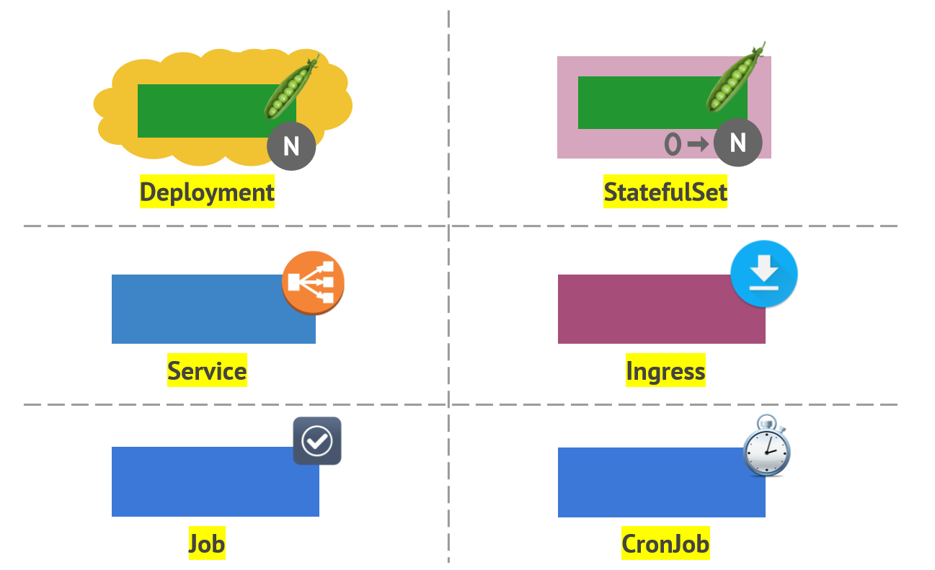
Kubernetes – primitives

Slide 45
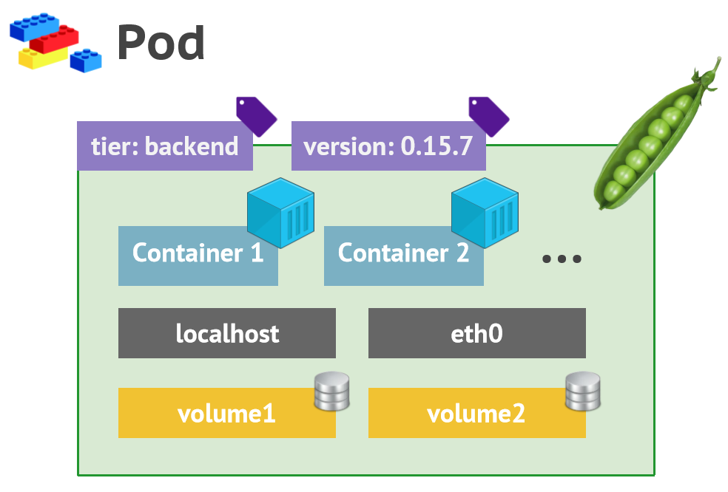
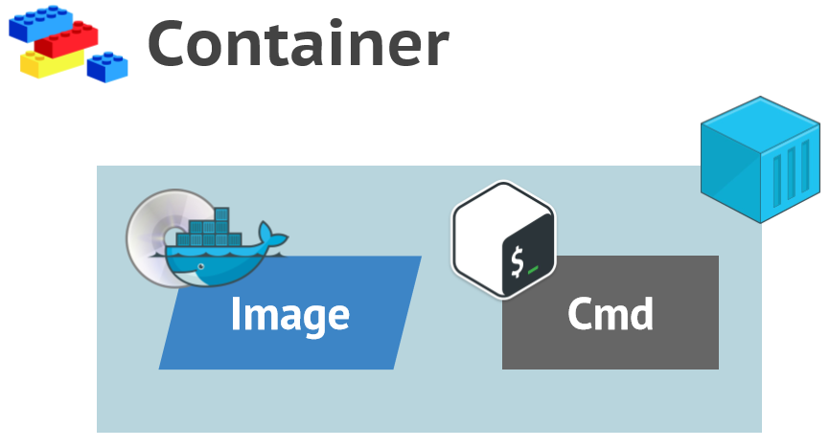
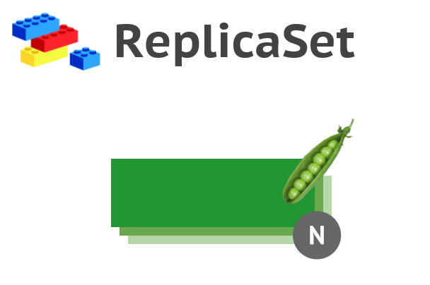
Kubernetes – primitives #1

Slide 46
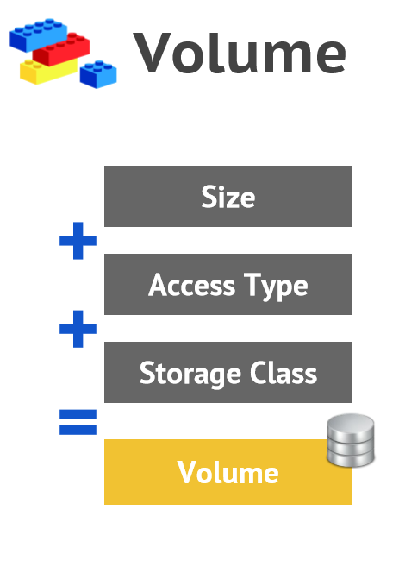
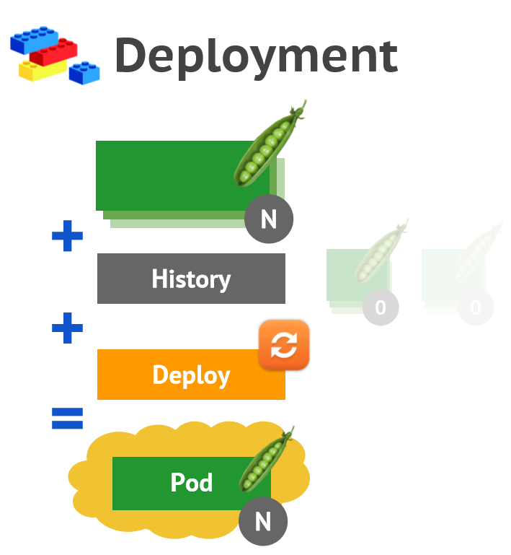
Kubernetes – primitives #3

Slide 47
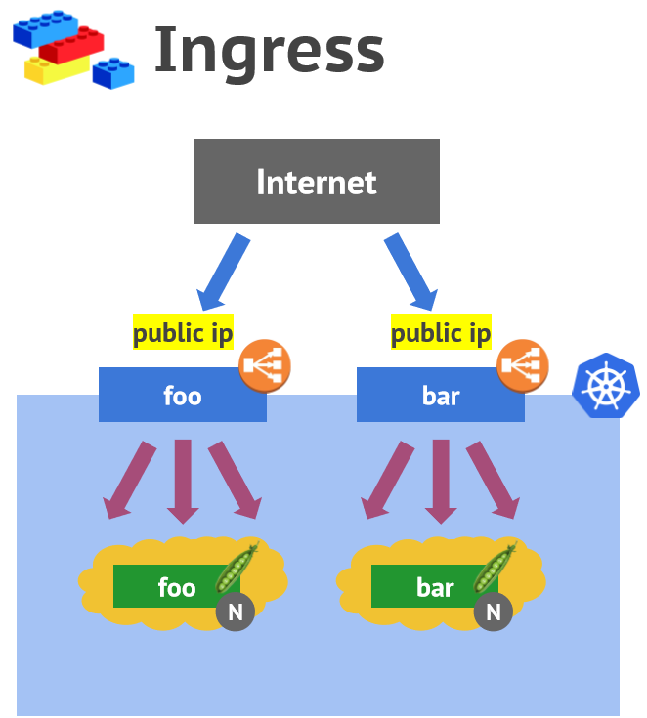
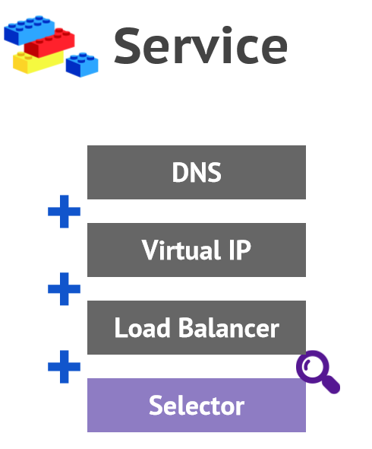
Kubernetes – primitives #2

Slide 48
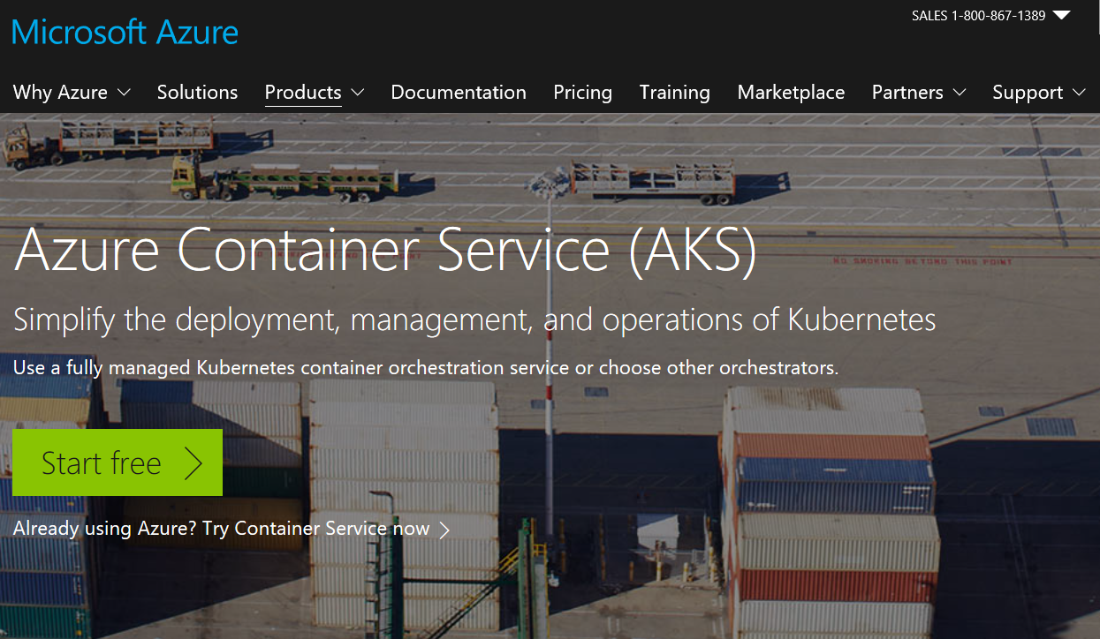
Challenge #3 – run Minecraft Kubernetes
Prepared Minecraft Server Docker container is available at: https://hub.docker.com/r/openhack/minecraft-server/
Use Azure Container Service (AKS):
https://azure.microsoft.com/en-us/services/container-service/

Slide 49
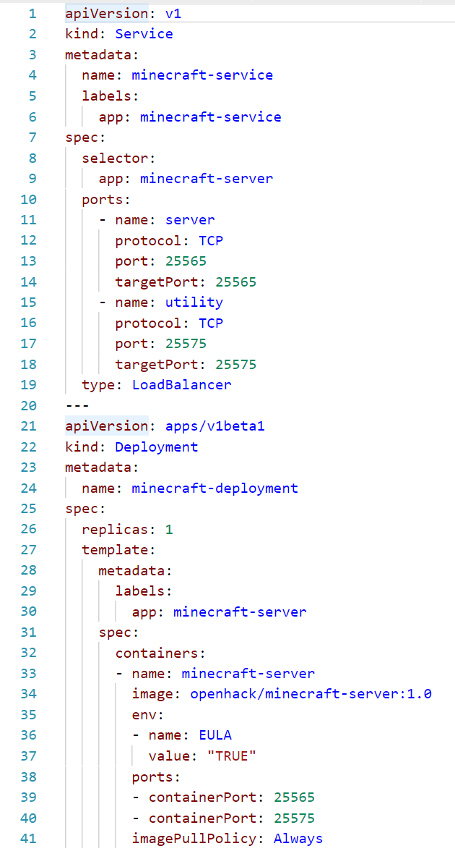
Challenge #3. Solution
Deployment.yaml
## Challange 3
# Register service providers for az shell
az provider register -n Microsoft.Network
az provider register -n Microsoft.Storage
az provider register -n Microsoft.Compute
az provider register -n Microsoft.ContainerService
# Crate AKS cluster
az group create --name LinuxConfEastUS --location eastus
az aks create --resource-group LinuxConfEastUS --name MinecraftClass --node-count 1 --generate-ssh-keys
# Install CLI extentions
az aks install-cli
# Login to the cluster
az aks get-credentials --resource-group LinuxConfEastUS --name MinecraftClass
# Show availible nodes
kubectl get nodes
# Start deployment
kubectl create -f deployment.yaml
# Check deployment status
kubectl get deployments
kubectl get pods
kubectl get services

Slide 50
Challenge #4 (Optional) – Stateful
What if deployed Pod will die?
Update deployment with stateful Pods
Documentation: https://docs.microsoft.com/en-us/azure/aks/azure-files-dynamic-pv

Slide 51
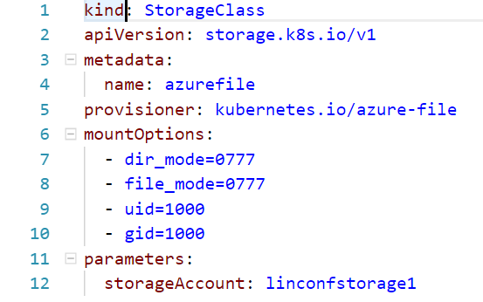
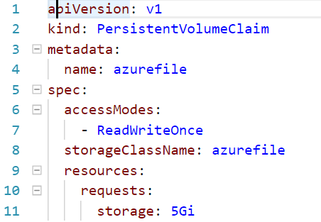
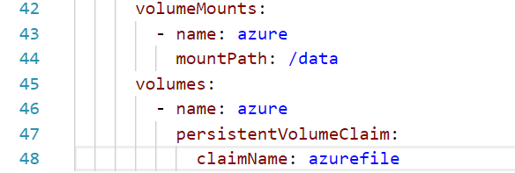
Challenge #4 (Optional). Solution
## Challenge 4
az group list --output table
az storage account create --resource-group MC_LinuxConfEastUS_MinecraftClass_eastus --name linconfstorage1 --location eastus --sku Standard_LRS
kubectl create -f storage-class.yaml
kubectl create -f storage-pvc.yaml
kubectl apply -f deploymant.yaml
storage-class.yaml
storage-pvc.yaml
deployment.yaml

